Slide 1
Capital One
Green Cab Challenge By Leang Chaing

Slide 2
Data Source
NYC Taxi & Limousine Commission
Green Cab Data (Outer Borough Pickups Only)
September 2015
1,494,926 trips
21 Fields (datetime, payment type, passenger count, trip distance, latitude/longitude, tip, total fare, etc.)

Slide 3
Distribution of Trip Distance
Trip distance has a long right tail with a mean higher than a median. Values have a lower boundary at 0, (distance can't be negative).
Plotting out the trip distance without outliers (> 3STDs) shows a lognormal distribution.

Slide 4
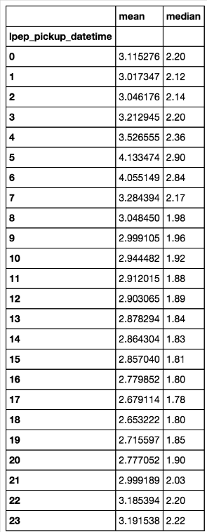
Average Hourly Trip Distance
Jumps in average distance traveled from 4-6 AM probably due to business travelers going to the airport to catch an early morning flight.
Slight increases in distance starting from 8PM might be due to post work commutes or traveling back from nights out.

Slide 5
Detecting Airport Travel
JFK & Newark Trips coded in dataset with ratecardID field (Jfk = 2, Newark = 3)
Used pickup & dropoff coordinates to identify LGA trips
Leveraged this method to also ID JFK & Newark trips
Identified 33.9K airport trips
Up from 5,552 coded via ratecardID
Mean fare: $34.33
Median fare: $31.84
Mean time trip time: 28 Mins

Slide 6
Distance Traveled – Airports vs Non-Airport
Overall non-airport travel is relatively is insensitive to time (except a minor bump from 5-6AM)
Newark has irregular hourly distance likely due to low sample size
JFK travel > LGA travel, implying more locals use LGA than JFK for flights
The overall 5-6AM bump seen a few slides over very likely due to airport travel and the increase we see here

Slide 7
Hourly Trip Length
Overall trips to the airports take longer than otherwise, except during the early mornings (less traffic? Easier shot to highways?)
2-4PM highest traffic times for Airport travel
Best times to leave for airport: 3-5AM, 11-12AM

Slide 8
Calculating Fare/Minute – Is It Better To Drive Cabs Locally Or To Airports?
Airport Trips Fare: $.99/min vs Non-airport Fare: $.60/min
Airport Trips Tip: $.13/min vs Non-airport Tip: $.06/min
T-tests proves statistical significance between two groups
Airport Trips generate more revenue per minute ($1.12 vs $.66) assuming no difference in downtime and they don’t need to double back without a fare. Otherwise it makes more sense to stick local

Slide 9
Predicting Tip Percentage
Cleaning
Feature Engineering
Modeling
Changing or Eliminating invalid datapoints
Evaluating Outliers (3 std beyond projected fare)
Date Data
Airport Trips
Speed
Hour
Projected Fare
Fare Difference
Tipped
Tip Percent (Dependent variable)
Classifier:
Logistic
Naïve Bayes
Ensemble Trees
Regressor:
Linear
Random Forests
XGBoost

Slide 10
Tip Classifier
XGBoost best performing classifier
Hyper-Parameters optimized for tree count & L2 regularization
Results cross-validated & tested against holdout
Result:
.956 AUC
.94 F1 Score

Slide 11
Tip Classifier – Best Predictors
Payment type (Credit Cards)
Log(Rate)
Hour of the Day
High proportion of tippers paying by CC suggests reporting bias vs difference in behavior i.e. cabbies not reporting cash tips

Slide 12
Tip Regressor
XGBoost best performing Regressor
Hyper-Parameters optimized for tree count, learning rate & L2 regularization
Results cross-validated & tested against holdout
Result:
0.00258 MSE
Top predictors:
Fare_Difference
Log(Rate)
Projected Fare
Combined models:
0.0029 MSE
.63 R^2

Slide 13
Future Work
In the future, I could improve this model through a variety of ways:
SVM & Neural Nets - SVM performs well with outlier data which I could incorporate into a future regressor. In addition, NNs are great at learning feature interactions so could detect a significant new feature that would improve the model.
Stacking models together - I could build out the various regressors tested and stack all the models together to create an ensemble model with lowered variance.
In addition, I could build out a regression model without any outliers to stack into the main model, which should reduce the overestimation in my model.
Pull in relevant geo-data - I hit some roadblocks due to computation and rate limiting. Neighborhoods could have a significant impact on tip percentage. Pickups/dropoffs at restaurant/bar-dense neighborhoods late at night have higher reported tipping rates either due to increased usage of credit cards or an inebriation effect

Slide 14
Anomaly Detection
Anomaly detector can detect cases of very lengthy and expensive cash trips that aren’t necessarily due to far distances.
Detector can be used to filter out these outliers in future data sets or detect drivers who choose suboptimal routes or horrible traffic occurrences.
Attempted to create a model to detect potential fraudulent records found in data – models could not predict presumed cases of fraud.
Unsuccessfully attempted to cluster anomalies to further evaluate similarities between anomalies due to low number of clusters.

Slide 15

Thank You!
Leang Chaing

